Slide 1

Miniproject(19AI701) – Review 3
DATA STORYTELLING WITH POWERBI
Submitted by:
SOWMIYA N (212221230106)
2021-2025 Batch
TEAM NO:TEAMDS06
Under the guidance of:
ARCHANA S H
Assistant Professor , Department of AIDS
DEPARTMENT OF ARTIFICIAL INTELLIGENCE AND DATA SCIENCE
SAVEETHA ENGINEERING COLLEGE
(Autonomous Institution – UGC, Govt. of India)
(Affiliated to Anna University, Approved by AICTE - Accredited by NBA & NAAC – ‘A’ Grade - ISO 9001:2015 Certified)
Saveetha Nagar, Thandalam, Chennai-602 105, TamilNadu, INDIA.

Slide 2
Agenda
Introduction
Statement of the Problem
Scope of the project
Methodology
Architectural Diagram
Flow
Algorithm used
Important code segments
Output, Results
Conclusions
References

Slide 3
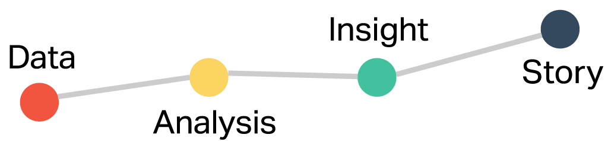
Introduction
DATA STORYTELLING WITH POWERBI
translating complex data analyses into understandable terms to influence business decisions and actions.
identify patterns and trends in numerical data, which might be difficult to discern from raw data.
Microsoft Power BI makes it easier for businesses to make informed decisions

Slide 4
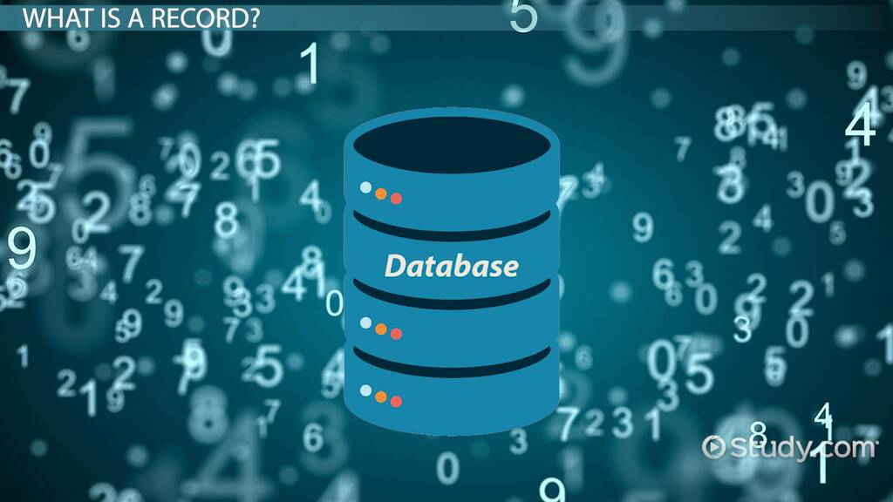
Statement of the Problem
Addressing challenges that businesses face in making sense of large volumes of numerical data.
Suboptimal decision-making
Making Communication with the end user difficult.

Slide 5

Scope of the project
Creating an interactive BI dashboard that help analyze raw data, identify patterns and trends, and enhance the firm's performance in the market.
Why PowerBI ?
Interactive Report Generation.
Updation of data.
Accessible among the organization.
Provides Mobile Interface.
Ease of Understanding

Slide 6
Methodology
DATA STORYTELLING WITH POWERBI
Data Collection
Data Cleaning
Exploratory Data Analysis
Dumping into SQL Database
Data Visualization with PowerBI
Interactive Dashboard Development
Testing and refinement

Slide 7
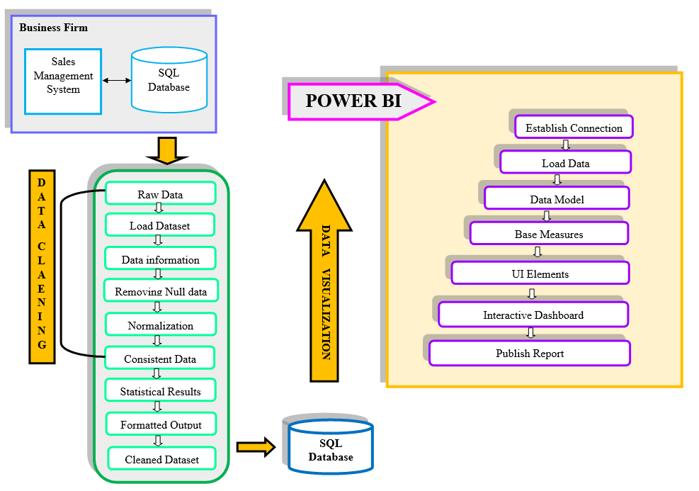
Architectural Diagram

Slide 8
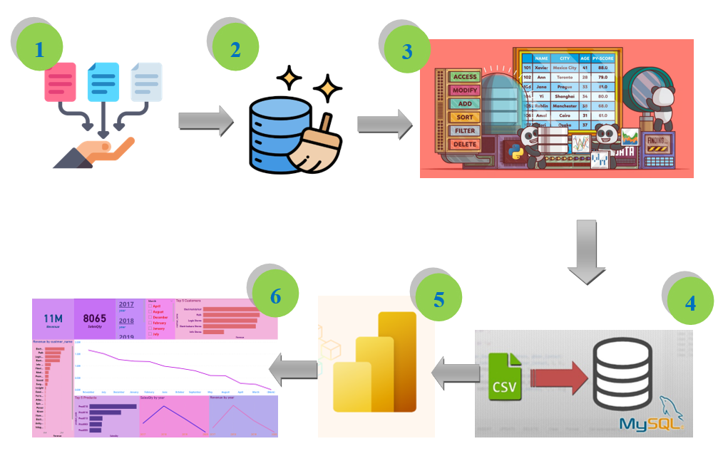
Flow Diagram

Slide 9
Algorithm
Collecting Raw data from the organization.
Data Cleaning using Pandas (Python library)
Perform EDA using pandas , numpy and user defined functions in Python
Export the cleaned data file using python
Establish a SQL server connection and dump the file into database
Connect the database to Microsoft PowerBI
Generate Interactive Dashboard
Testing and Refinement - SQL Query
Publish the report

Slide 10
Important Code segments
Python
import pandas as pd #Python Data Analysis Library
data=pd.read_csv(‘file_name.csv’) #Read CSV file
data #Display the dataframe
data.info() #Find the non null count from the data
data = data.dropna() #Drop the null values
duplicates = data[data.duplicated()] #Duplicate data
data = data.drop_duplicates() #Drop the Duplicate data
data.to_csv('eda_products.csv', index=False) #To generate CSV file

Slide 11
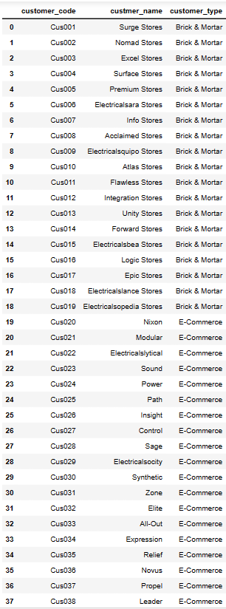
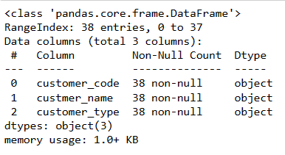
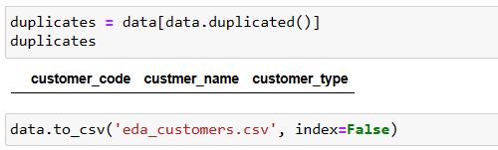
Output – Dataset 1
Dataset – Customer
1
2
3

Slide 12
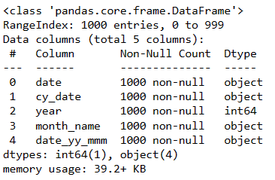
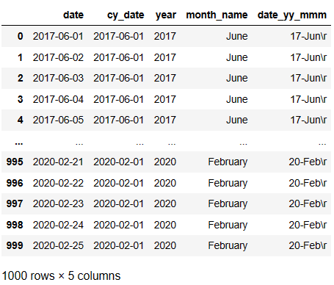
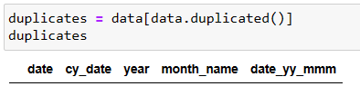
Output – Dataset 2
Dataset – Date
2
1
3

Slide 13
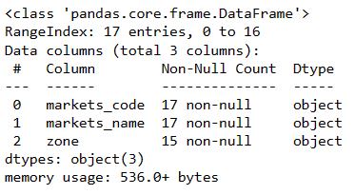
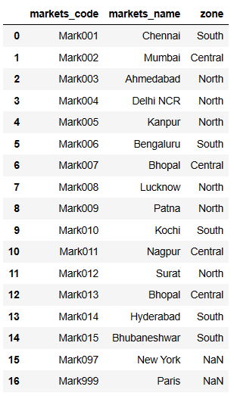
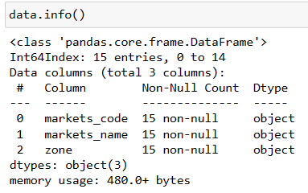
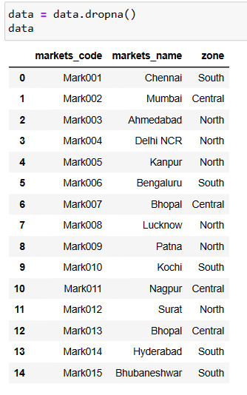
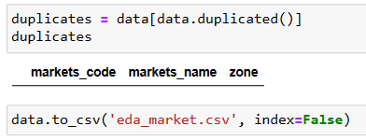
Output – Dataset 3
2
Dataset – Market
1
4
3
5

Slide 14
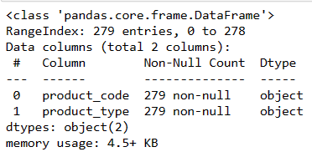
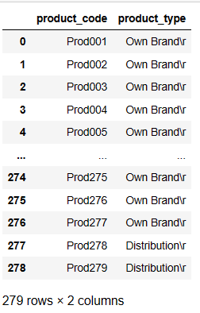
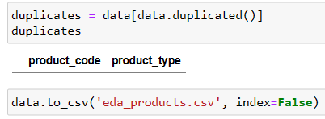
Output – Dataset 4
Dataset – Products
2
1
3

Slide 15
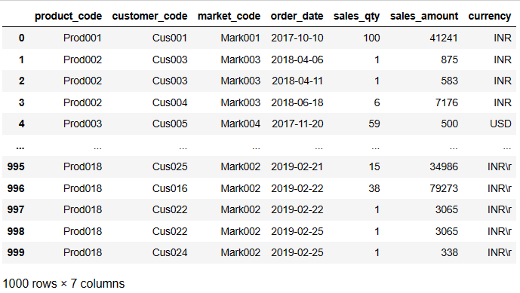
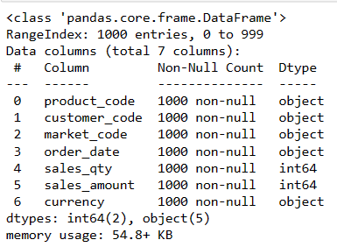
Output – Dataset 5
Dataset – Transaction
1
2

Slide 16
Dataset 5 - Code Segment
currency= data['currency’] #Displays the column - currency
print(currency)
unique_values = data['currency'].unique() #Displays the values of column
unique_values
value_counts = data['currency'].value_counts() #Displays the count of the value
value_counts
data['currency'] = data['currency'].str.replace('INR\r', 'INR’) #ValueReplacement data['currency'] = data['currency'].str.replace('USD\r', 'USD')
Data
usd_data = data[data['currency'] == 'USD’] #Displays records that has USD type
usd_data
def convert_to_inr(row): #Convert USD to INR
if row['currency'] == 'USD':
return row['sales_amount'] * 75
else:
return row['sales_amount']
data['sales_amount'] = data.apply(convert_to_inr, axis=1)
data

Slide 17
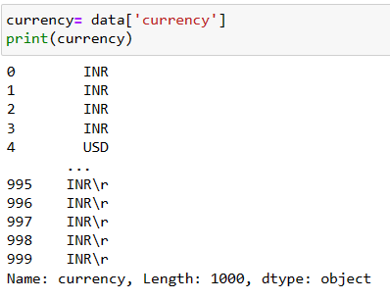
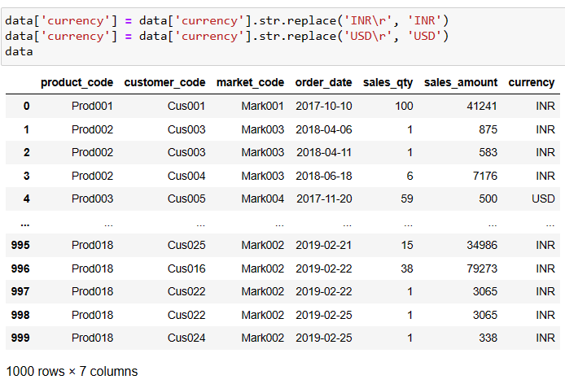
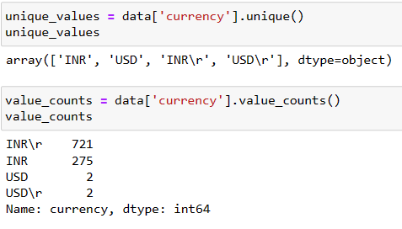
Output – Dataset 5
3
5
4

Slide 18
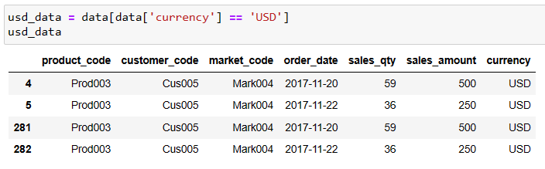
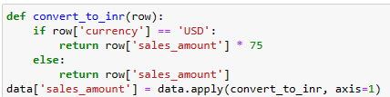
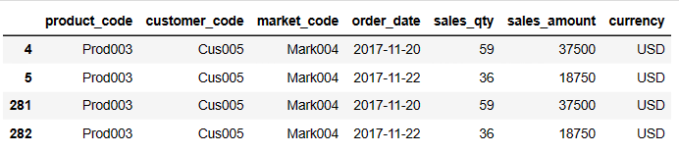
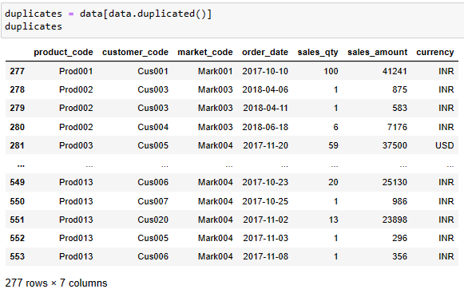
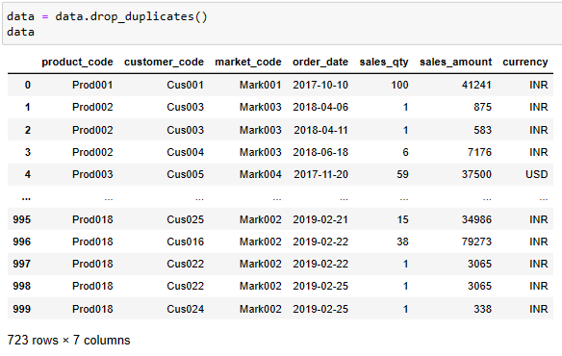
Output – Dataset 5
5
6
7
8

Slide 19
Dataset 5 - Code Segment
Data Analysis
total_sales_sum = data['sales_amount'].sum() #total revenue
total_sales_sum
total_sales_qty = data['sales_qty'].sum() #total sales qty
total_sales_qty
# overall revenue based on month
data['order_date'] = pd.to_datetime(data['order_date’])
monthly_sales_sum=data.groupby(data['order_date'].dt.month)['sales_amount'].sum()
monthly_sales_sum
# overall sales qty based on month
data['order_date'] = pd.to_datetime(data['order_date'])
monthly_sales_qty = data.groupby(data['order_date'].dt.month)['sales_qty'].sum()
monthly_sales_qty
# revenue based on year
data['year'] = data['order_date'].dt.year
yearly_sales_sum = data.groupby('year')['sales_amount'].sum().reset_index()
yearly_sales_sum

Slide 20
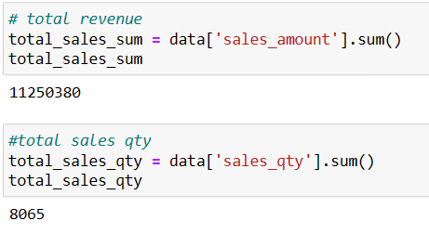
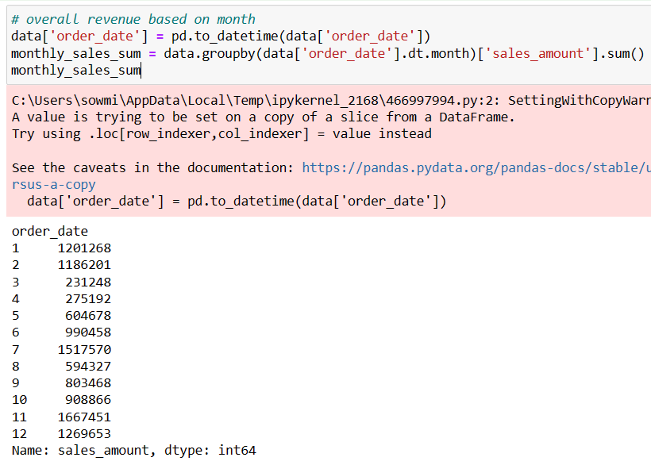
Output – Dataset 5
1
2
3

Slide 21
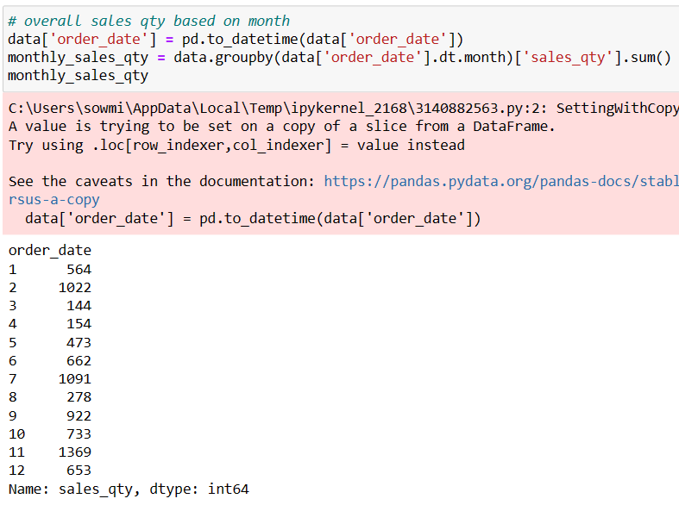
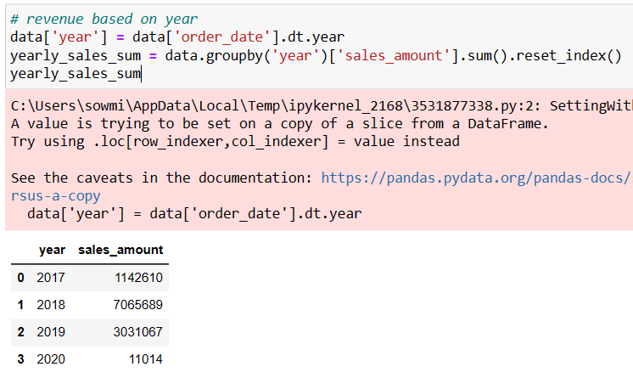
Output – Dataset 5
4
5

Slide 22
Dataset 5 - Code Segment
Data Analysis
# sales qty based on year
data['year'] = data['order_date'].dt.year
yearly_sales_qty = data.groupby('year')['sales_qty'].sum().reset_index()
yearly_sales_qty
#revenue based on year and month
data['month'] = data['order_date'].dt.month
data['year'] = data['order_date'].dt.year
yearmonth_sales_sum = data.groupby(['year', 'month'])['sales_amount'].sum()
yearmonth_sales_sum
# sales qty based on year and month
data['month'] = data['order_date'].dt.month
data['year'] = data['order_date'].dt.year
yearmonth_sales_qty = data.groupby(['year', 'month'])['sales_qty'].sum()
yearmonth_sales_qty

Slide 23
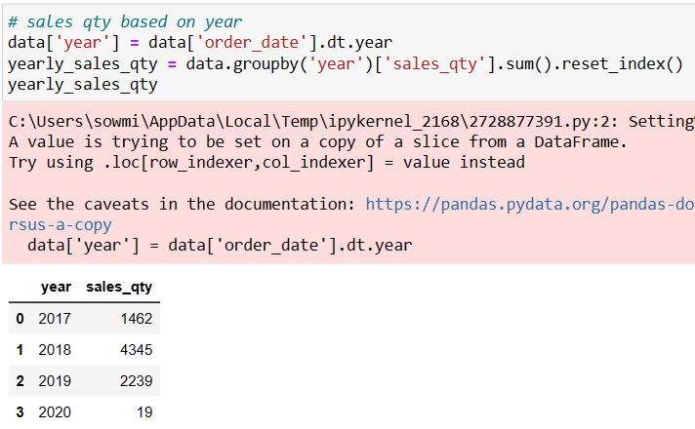
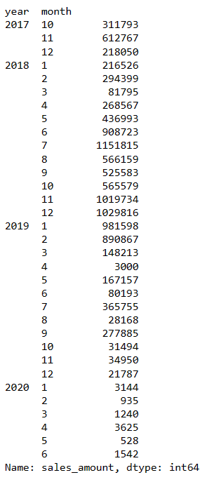
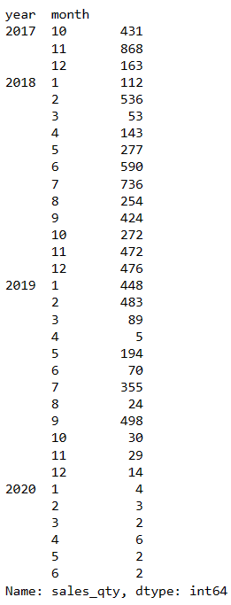
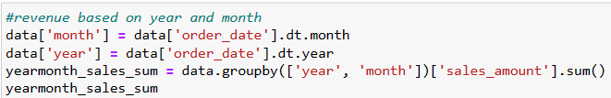
Output – Dataset 5
6
8
7

Slide 24
Dataset 5 - Code Segment
# to calculate revenue based on the customer code
merged_data = pd.merge(data, customerdata, on='customer_code', how='inner')
customer_revenue = merged_data.groupby('customer_code')['sales_amount'].sum().reset_index()
print(customer_revenue)
# to calculate sales qty based on the customer code
merged_data = pd.merge(data, customerdata, on='customer_code', how='inner')
customer_qty = merged_data.groupby('customer_code')['sales_qty'].sum().reset_index()
print(customer_qty)
# to calculate sales qty based on the product code
product_sales_qty = data.groupby('product_code')['sales_qty'].sum().reset_index()
product_sales_qty

Slide 25
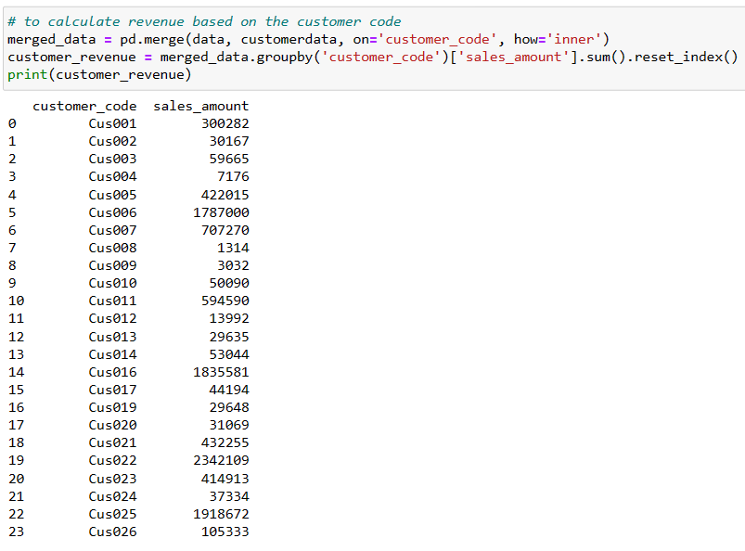
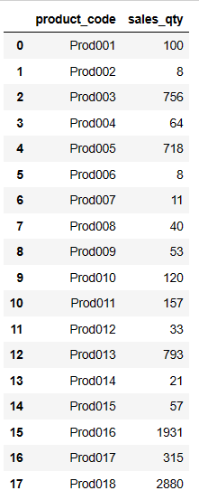
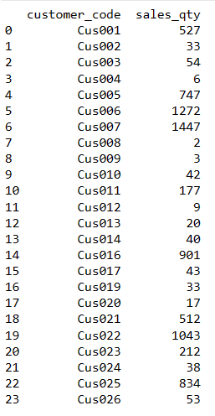
Output – Dataset 5
9
10
11

Slide 26
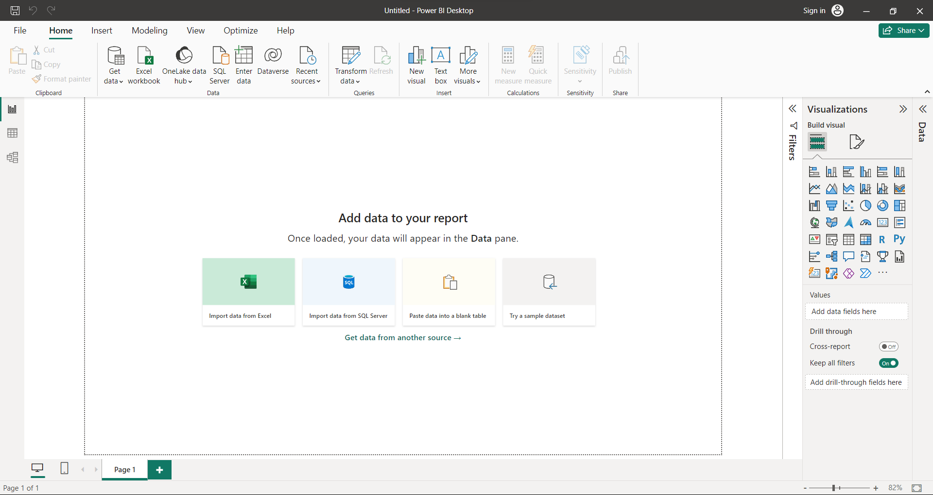
PowerBI
Base Measure

Slide 27
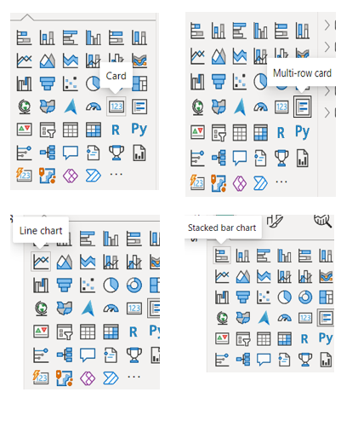
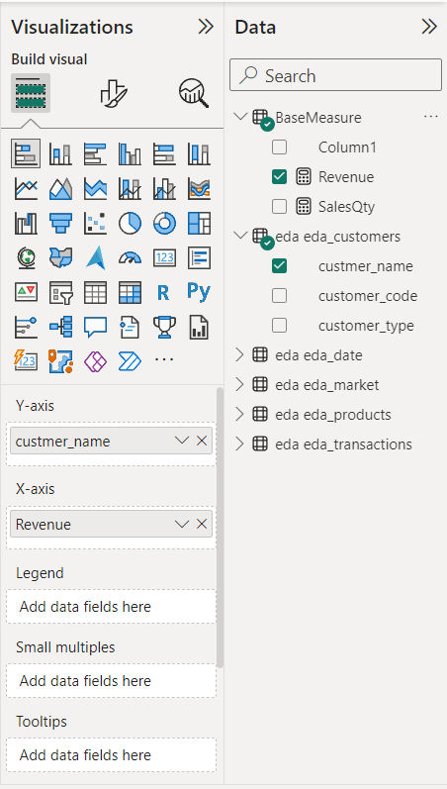
PowerBI

Slide 28
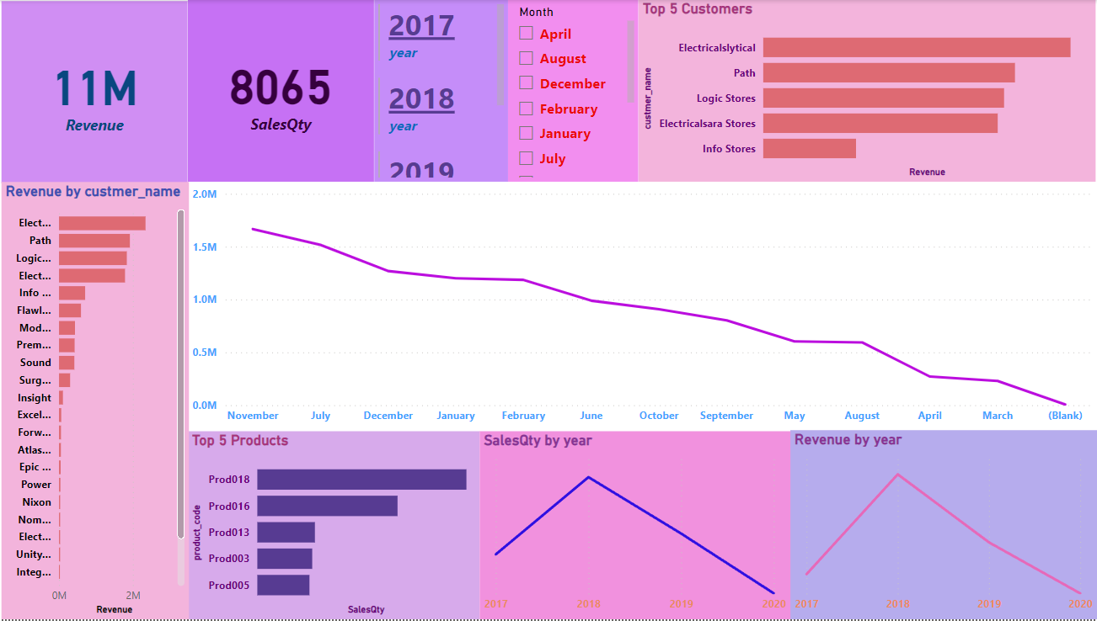
PowerBI

Slide 29
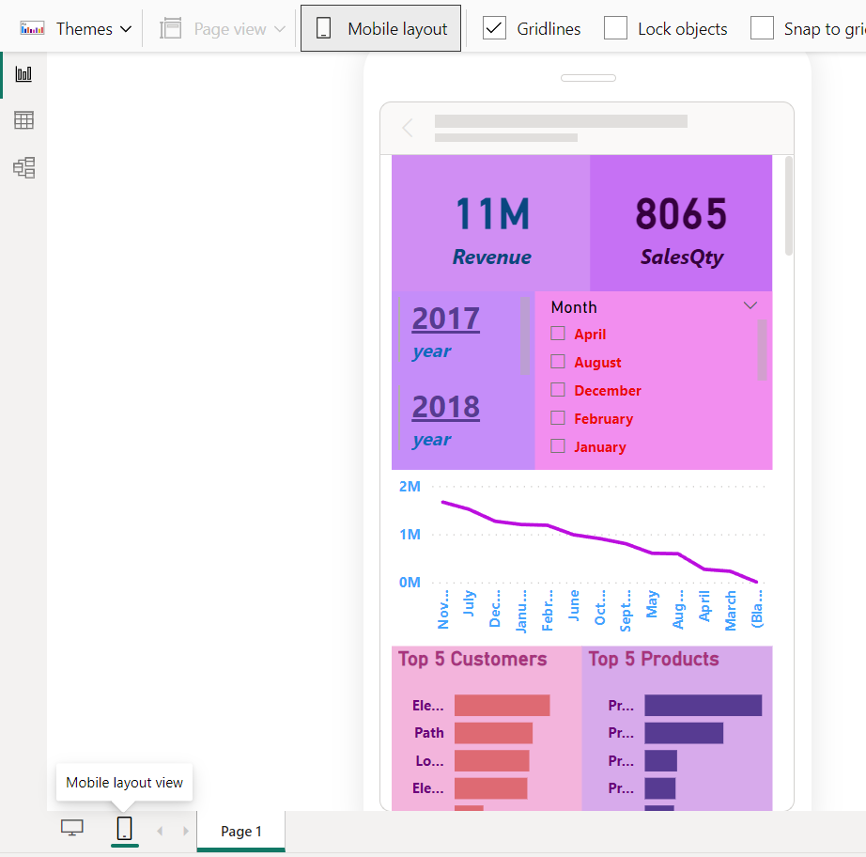
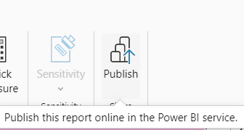
PowerBI

Slide 30
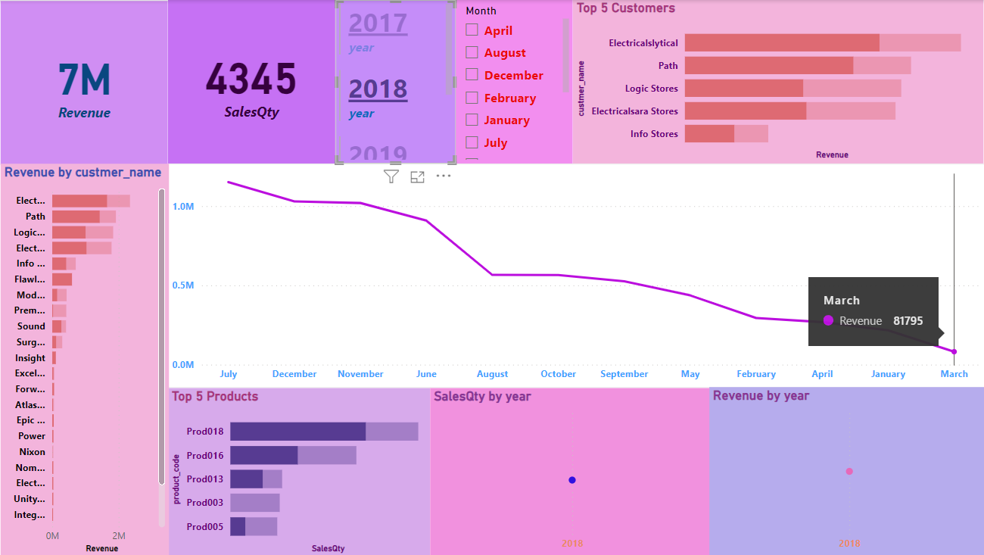
Testing

Slide 31
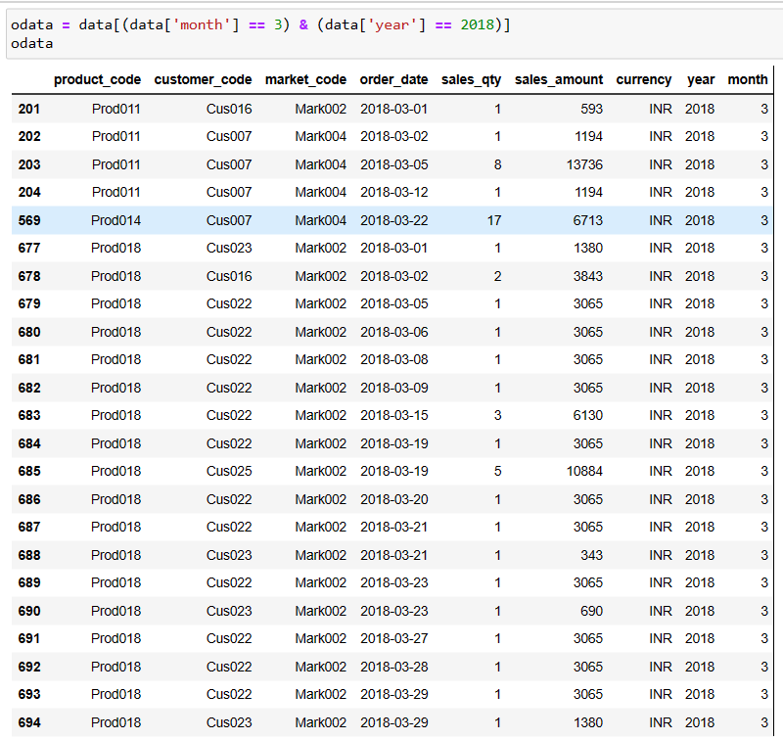
Testing

Slide 32
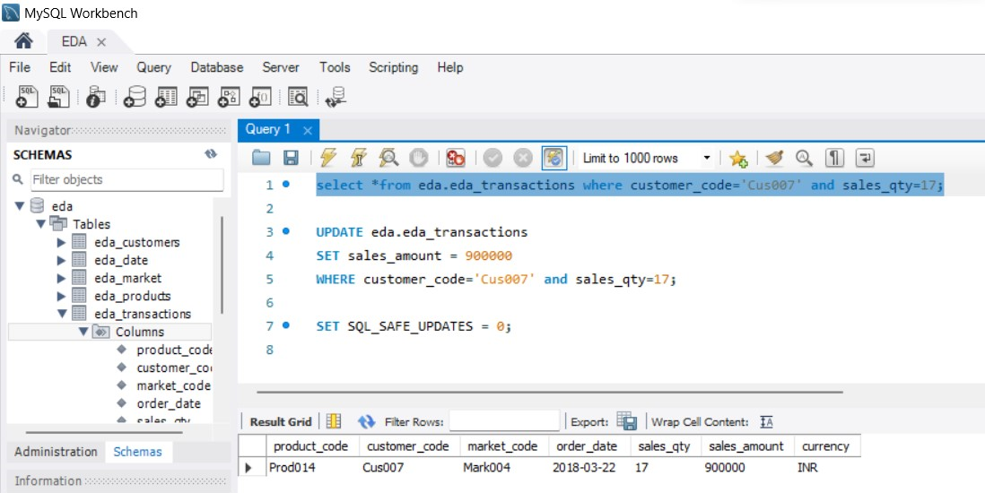
Testing

Slide 33
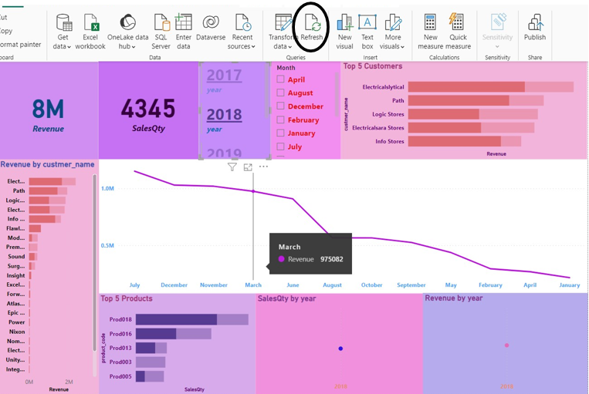
Testing

Slide 34

Conclusion
Large volume of data can be easily visualized.
Improved decision making
Can easily communicate with the end user.

Slide 35
References
Papers
https://www.researchgate.net/publication/321804138_Data_Visualization_for_Business_Intelligence
https://www.researchgate.net/publication/352735133_Data_Visualization_A_Study_of_Tools_and_Challenges
https://www.ijsce.org/wp-content/uploads/papers/v7i3/C3011077317.pdf
Books
Cole Nussbaumer Knaflic “Storytelling with Data” : A Data Visualization Guide for Business Professionals
Andy Kirk “ Data Visualisation” : A Handbook for Data Driven Design 2019
Suren Machiraju, Suraj Gaurav “Power BI Data Analysis and Visualization” 2018
Brian Larson · “Data Analysis with Microsoft Power BI” 2020
Brett Powell “Mastering Microsoft Power BI” : Expert Techniques for Effective Data Analytics and Business Intelligence 2018

